Slide 1

Tech Experience
Pivot Park Screening Centre

Slide 2


Melik Burak Bozbey
Technical-minded and
a learning-addict,
senior electrical and electronics engineering student
Seeking to leverage
my knowledge and expertise in machine learning, computer vision and signal processing with the hands-on working experience.

Slide 3
Challenge 1
01
Challenge 2
02
TABLE OF CONTENTS
Challenge 3
03
Conclusion
04
References
05
Can we detect automatically that a suspicious pattern occurs?
Can we analyse the physical situation?
Can AI be used to improve quality and efficiency of the robot system?
Overall review of proposed methods

Slide 4

Challenge 1
Can we detect automatically that a suspicious pattern occurs?

Slide 5
Problem
Human supervision is not efficient and effective for the maintenance of a 24/7 operation.
Unidentified errors in process may result in significant damage without human supervision.
Pattern recognition is not possible when during the unattended hours of operation.
Any failure in test procedure directly impacts revenue and time spent on overall process.

Slide 6
Solution 1: Pattern Detection After Test
Machine learning can solve pattern recognition tasks with supervised learning.
A dataset can be prepared from test results. If a suspicious pattern is detected by expert, the test result should labeled with possible error:
TestID | Timestamp | Parameter1 | Parameter2 | … | Label
111 | 2012-12-15 11:15:09.205 | 3.632 | 1023 |  | Successful
112 | 2012-12-14 11:15:09.205 | 2.786 | 987 | … | Inaccurate Dispensing
. . | . . | . . | . . | … | . .
113 | 2012-12-13 11:15:09.205 | 4.145 | 987 |  | Loss of Reagent Stability
After dataset prepared with both succesful results and anomalous results with enough variety, a machine learning model can be trained to classify test results and used for future tests.

Slide 7
Value Proposition
Unattended hours of operation can be controlled by machine learning model.
If machine learning model identifies an anomaly from test results after process, any action can be taken accordingly. i.e. restart testing procedure if there exists an anomaly in centrifuge process
Machine learning model can outperform expert analysis which minimizes human error. [1]

Slide 8
Dataset Preparation
Machine learning models’ performance significantly depends on dataset quality when using supervised learning algorithms.
Prepared dataset must be labeled correctly and each label must have enough samples to represent distribution of the anomaly so, large datasets may needed.
The dataset preparation step is labor-intensive but machine learning models make overall automated testing task more efficient and effective.

Slide 9
Machine Learning Procedure
Label Dataset
Perform Analysis on Dataset
Select Right Algorithm
Train Machine
Learning Model
Monitor Performance and Update Model
Classify Test Results 24/7
Deployment
to Production
Evaluate Performance of
the Model

Slide 10
Model Evaluation
If dataset includes small percentage of a label, i.e. %0.5 of test results that are labeled as inaccurate dispensing in dataset, evaluation metric of machine learning model must be chosen properly due to imbalanced label representation.
Since each instance in dataset represent anomaly/non-anomaly label and actions are taken according to label, chosen metric is crucial for using trained machine learning model in production.
In model evaluation step, several evaluation metrics can be used:
F1 score
Precision
Recall
ROC Curve
After evaluation with these metrics, we can use the trained model to classify every test, if trained model satisfies our constraints.

Slide 11
Solution 2: Pattern Detection During Test
For real-time detection of unwanted patterns during testing, we need continuous data-streams from
the instrument.
After labeling each data-stream with correct anomaly or non-anomaly and training a model in a similiar way as in slide 9, trained machine learning model (inference model) can identify patterns during the test process and take action according to its prediction. i.e. if there’s a problem in centrifuge process, restart
centrifuge process and continue testing
For a real-time machine learning application, latency is important factor which affect the success of
the action that is determined by machine learning model. Inference model can be used on a cloud server
or on edge.

Slide 12
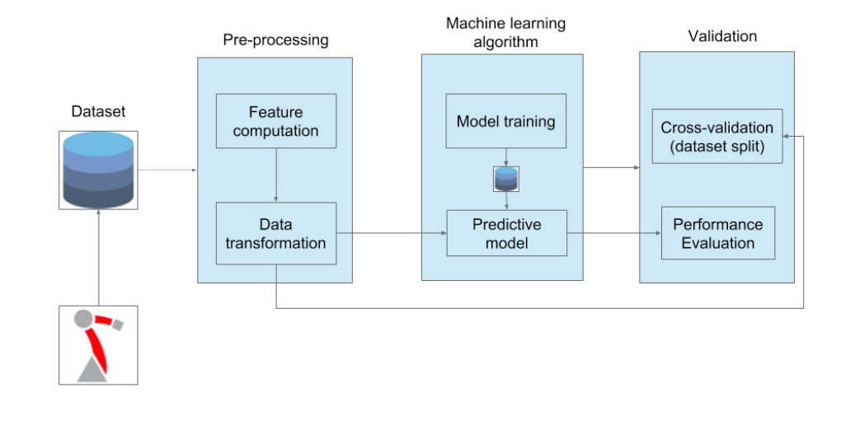

Real-time Machine Learning Procedure
Model Training
Continuous Data
Inference Model
Predicted Action

Slide 13
Model in Production: Cloud or Edge?
If machine learning model deployed on cloud server, latency, network failure or low bandwidth affect
real-time detection.
Machine learning models that work on edge -local computation units- are faster and efficient for real-time anomaly detection to take action on each scenario but may face with power, memory and computational constraints with respect to complexity of machine learning model.
According to a research [2], in most industries, on edge computation is more efficient and effective than
relying on cloud computation.

Slide 14
Challenge 2
Can we analyze the physical situation?

Slide 15
Problem
Human supervision is not efficient and effective for the maintenance of a 24/7 operation.
Machine failures are time-consuming and expensive process if there is not any established predictive maintance system.
Maintanence of robotic process is not possible when during the unattended hours of operation.
Any failure in machines directly impacts revenue and time spent on overall test process.

Slide 16
Solution 1: Machine Learning
Machine learning can solve maintenance problem with supervised learning.
A dataset should be prepared from tracking data points such as sensor data from robots or current testing step. If a failure happens, all data points and state of the machine should be labeled as failure and vice versa:
MachineID | Timestamp | Heat | Speed | … | Label
1 | 2012-12-15 11:15:09.205 | 28.25 | 102 |  | No failure
1 | 2012-12-15 11:16:09.205 | 28.26 | 102.1 | … | Failure due to X
. . | . . | . . | . . | … | . .
8 | 2012-12-16 11:15:09.205 | 46.2 | 89.2 |  | No failure
After dataset is prepared, machine learning models can be trained to achieve 24/7 predictive maintenance task which proactively determined before any failure happens.

Slide 17
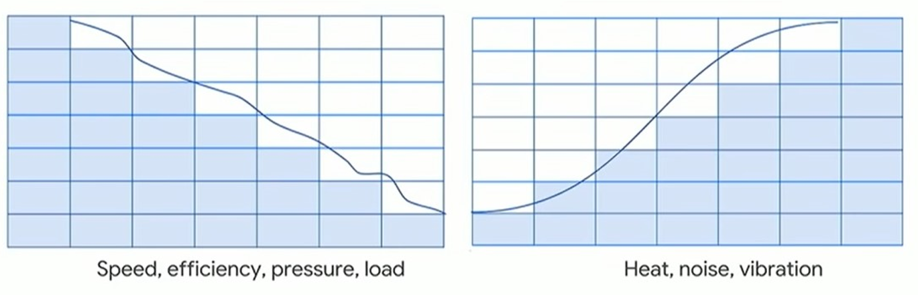
Solution 1: Machine Learning
Machine learning algorithms can learn patterns of machine failure by using prepared dataset.
Source: [3]

Slide 18
Solution 1: Machine Learning
For predictive maintenance, we need to establish a hypothesis such as manipulation of the dataset to look
overall objective as predicting failure in 2 weeks. After dataset manipulated in this manner, we can predict a
failure in instruments before it happens and can take action.
MachineID | Heat | Speed | … | Label
1 | 28.25 | 102 |  | No failure in 2 weeks
2 | 28.26 | 102.1 | … | No failure in 2 weeks
. . | . . | . . | … | . .
8 | 46.2 | 89.2 |  | Failure in 2 weeks

Slide 19
Solution 2: Image Recognition
Machine learning algorithms including deep convolutional neural networks can recognize an instrument
failure from images if there exist any visual representation of failure from by using video surveillance.
If it’s possible to detect an instrument failure from images that are gathered from video surveillance, multiple
cameras can be assigned to each robotic arm for data preparation.
Multiple image sources can provide physical situation of each instrument in every angle.

Slide 20
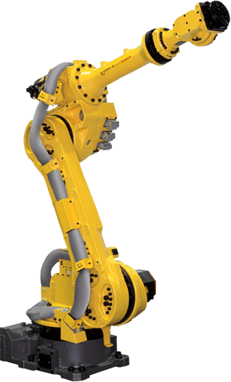
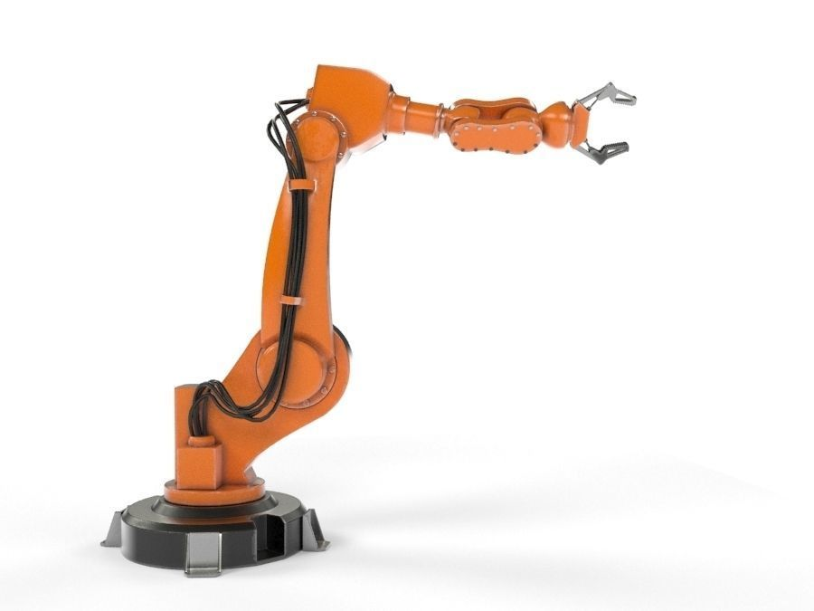
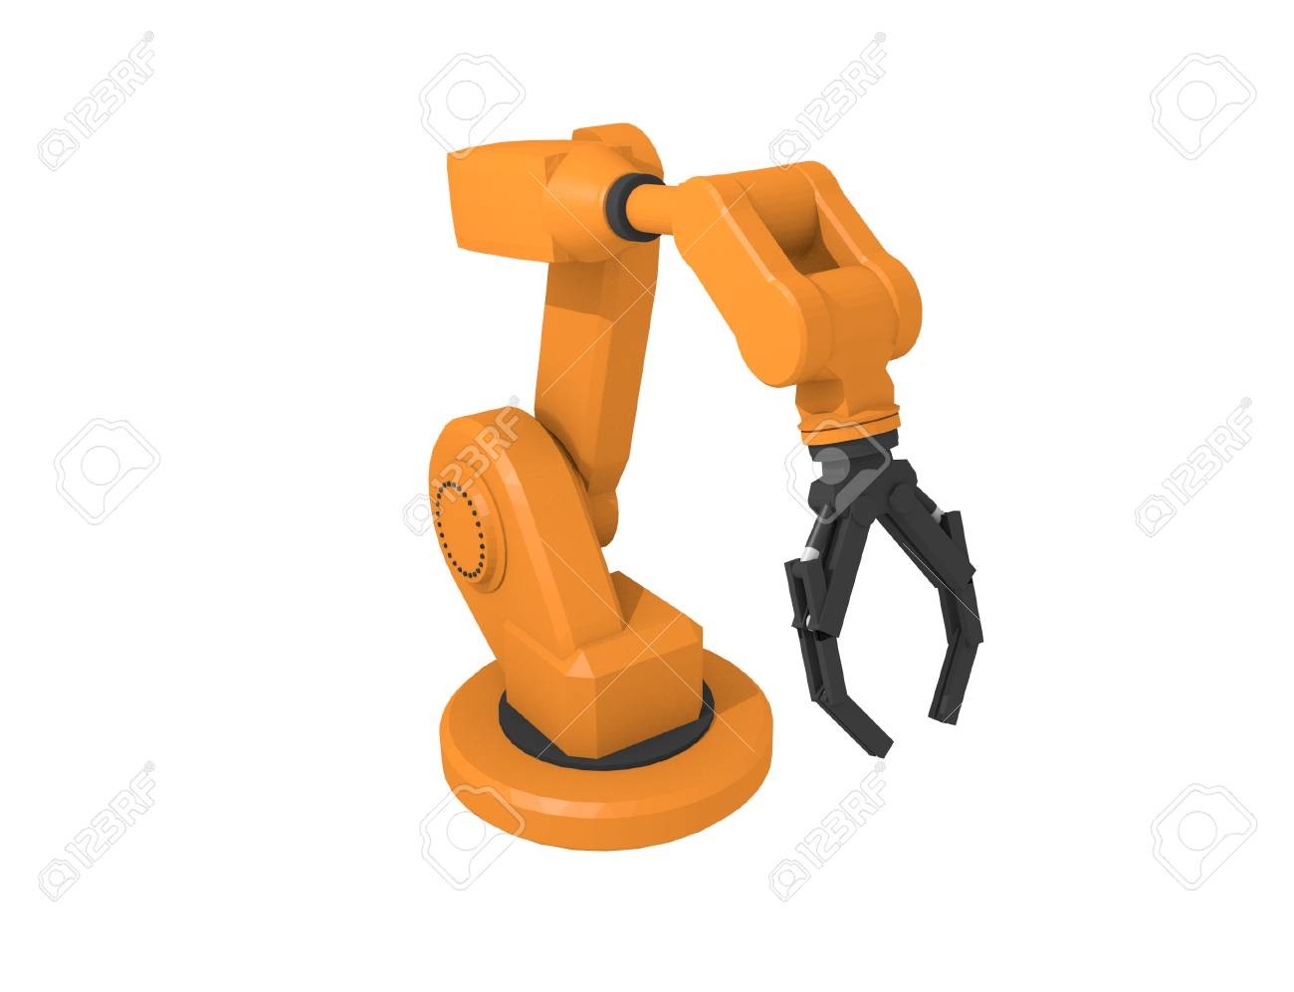
Solution 2: Image Recognition
After collecting enough data for deep learning algorithms, the dataset needs labeling for each
situation such as:
MachineID | Label
Arm1_Image1 | No Failure
Arm1_Image2 | Motor Failure
. . | . .
Arm8_Image6 | Power Failure
Arm1 Arm2 Arm8
After labeling, same procedure in slide 9 should be applied to detect any failure from physical situation of the instrument.

Slide 21

Training : Image Recognition Model
Camera1
Camera2
Camera3

Slide 22
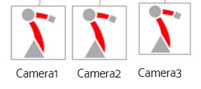
Inference : Image Recognition Model
Predicted Action 1
Trained Model
Majority Voting
Predicted Action 2
Predicted Action
Predicted Action 3

Slide 23
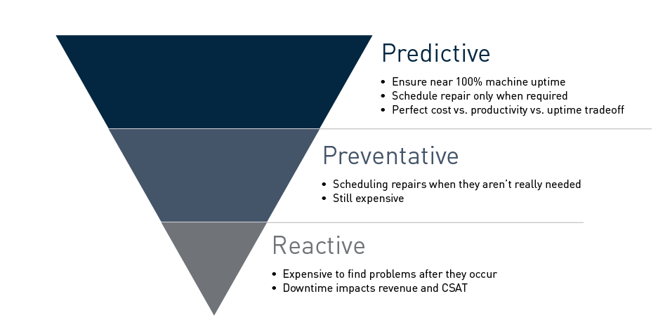
Value Proposition
Predictive maintenance of instrument failures are efficient and effective in comparison to reactive
maintenance
Source: [4]

Slide 24
Reduce Downtime
Schedule Repair
PREDICTIVE MAINTENANCE
24/7 Successful Operation
Less Human Supervision
Using predictive maintenance reduces downtimes in 24/7 operation
If the model classifies a machine as «needs repair» with respect to established hypothesis,
proactive actions can be taken.
Since overall objective is less human intervention and successful operation at day and night, predictive maintenance is an efficient method.
Unnecessary replacement or repair of any instrument can be reduced and less action will be taken by using data-driven predictive maintenance.

Slide 25
Challenge 3
Can AI be used to improve quality and efficiency of the robot system?

Slide 26
AI & Robotics
AI is a general term that implies the use of models to replicate intelligent human behavior.
In scope of pivot park’s case, we can use specialized AI as a starting point.
Specialized AI in this case is a term for a robot that perform only special tasks, such as the centrifuge process, seal removal or transfering compound to test plate.
Since these steps are already automated, we can use specialized AI for each step that needs human supervision in this process which can be replicated by a machine learning model.
In a 24/7 working operation, we can maximize operational efficieny by proactively taking action with predictive maintenance and utilizing testing procedure with more reliability with suspicious pattern recognition.

Slide 27
AI & Robotics
Machine learning models can learn patterns as well as visual representations from data. If AI & robotics are integrated, robots can sense and learn which mimics human behaviour.
These models can be used for finding damaged test samples, identification of errors in testing
procedure from samples and prediction of machine failure in near future.
For establishment of these systems, the procedure needs data-driven robotics approaches, which makes
data gathering operation more crucial while building AI-assisted automated system.
Since machine learning is heavily depend on dataset quality, data preparation step needs labor-intensive labeling process.

Slide 28
Conclusion
Overall review of proposed methods

Slide 29
Conclusion
In this presentation, several methods are proposed with respect to given challenges.
Predictive maintenance is widely used around different industries to prevent machine downtime
Since machine learning heavily depends on dataset quality, this labor-intensive task needs investment
on dataset preparation and data pipelines for real-time predictive maintenance with machine learning.
Future improvements can be established over these proposed methods with better domain knowledge on high throughput screening and development of medicine.

Slide 30

THANKS
Feedbacks are appreciated. Contact Information:
mburakbozbey@outlook.com
+90 554 381 11 60
https://mburakbozbey.github.io/

Slide 31
REFERENCES
https://www.bbc.com/news/health-50857759
https://www.iotworldtoday.com/2020/01/30/edge-computing-benefits-for-ai-crystallizing/
https://www.youtube.com/watch?v=4wneZDEB3VA
https://mapr.com/solutions/ai-analytics/predictive-maintenance/

